Slide 1
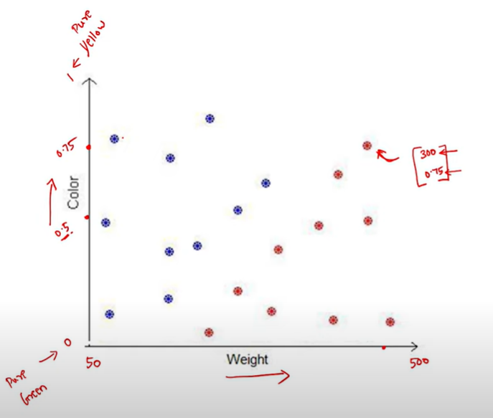
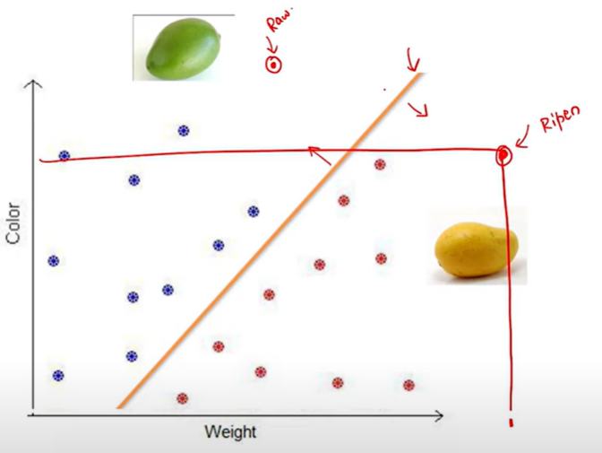
Machine Learning Paradigms 1.Introduction to various components of machine learning 2.Feature representation 3.Classification
ML algorithm enables machines to classify mangoes as Raw and Ripen
Features (characteristics) are represented as numbers for machines to learn. Both weight and colour enables classification
Line separates Mango as Raw or Ripen based on the datasets and individual datapoints are not further required to classify new mango
Machine learning is identification of separator (line) based on the features/labels information available in the datasets

Slide 2
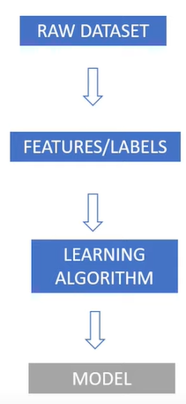
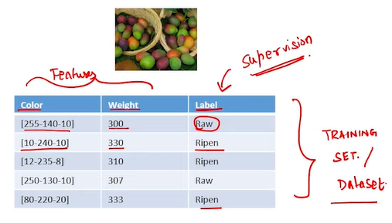
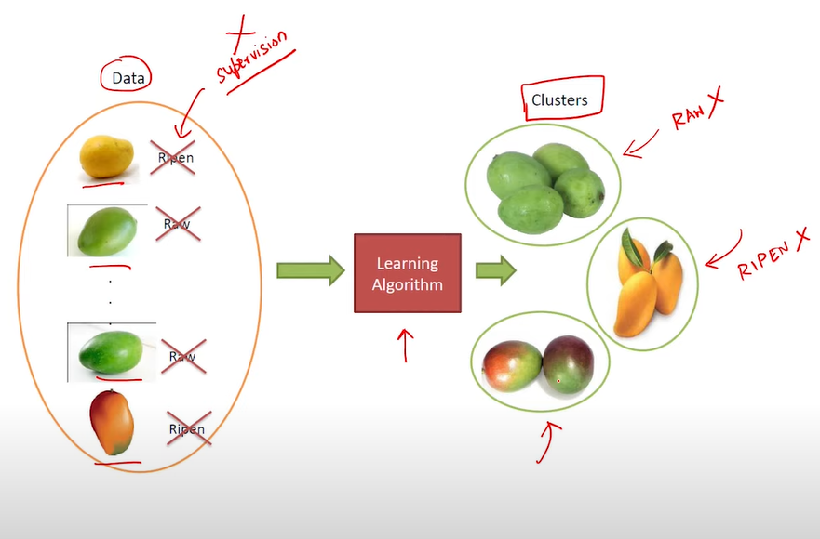
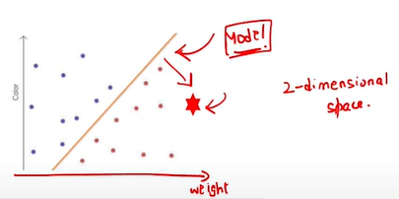
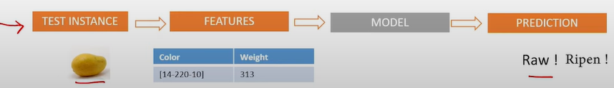
Supervised/Unsupervised Learning Supervised learning setup with terminologies, Unsupervised learning and its applications
This is supervised learning as label information (as Supervision) is available
The model predicts raw/ripen based on the feature information.
There are no supervision (raw/ripen) details in the unsupervised learning
Algorithm group the data (mango) based on the features but cant identify it as raw or ripen

Slide 3


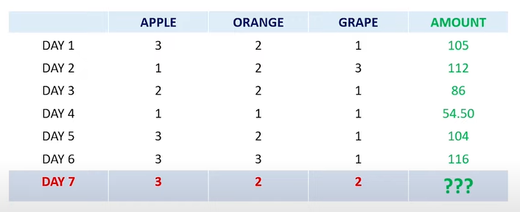
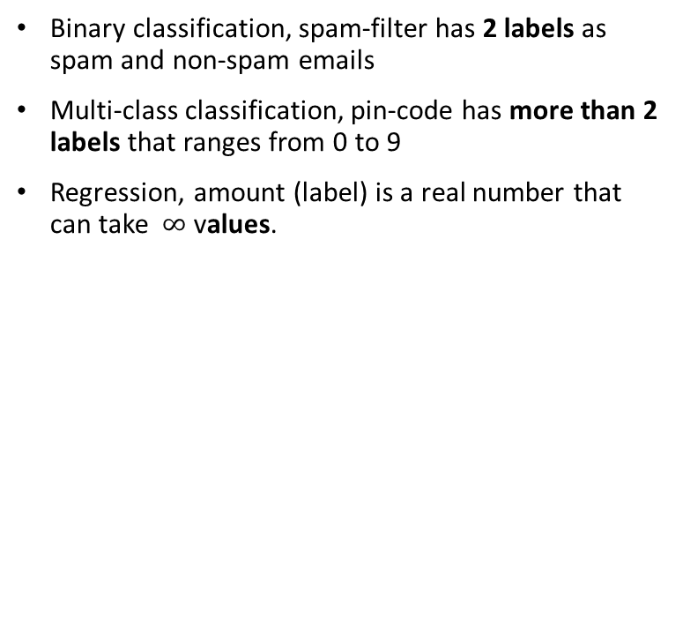
Types of Supervised learning Classification and Regression problems
Binary classification, spam-filter has 2 labels as spam and non-spam emails
Multi-class classification, pin-code has more than 2 labels that ranges from 0 to 9
Regression, amount (label) is a real number that can take $∞$ values.

Slide 4
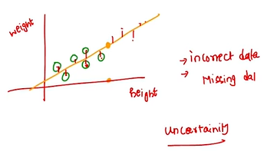
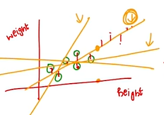
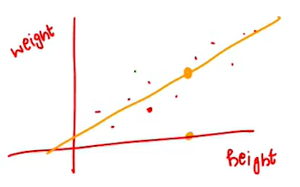
Mathematical Tools A brief introduction to mathematical tools required to understand machine learning algorithms
Linear algebra study about the line’s properties that relates the height and weight.
Probability study about uncertainties in data that doesn’t follow the structure
Optimization study about the best fit line out of the infinite lines

Slide 5
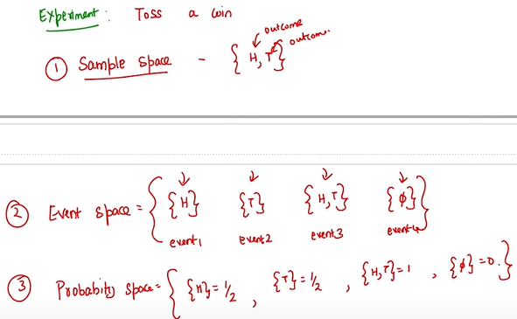
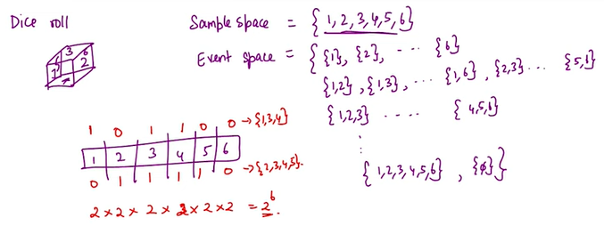
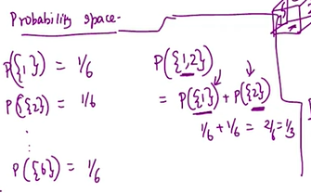
Three Fundamental Space Sample space, Event space, probability space, computing probability for union and intersection of events
Sample space (possible outcomes), event space (possible questions from the experiment), probability space (chances for event) are important for probability theory
For a dice roll, event space has 64 sets (2 power of 6) since each side will have 2 outcomes (0,1)
P{1,2} is a disjoint event because if event 1 occurs while rolling dice event 2 doesn’t occur for same event or vice versa
For disjoint event, probability for P{1,2} is sum of probability of individual events P{1} and P{2} as per probability rule

Slide 6
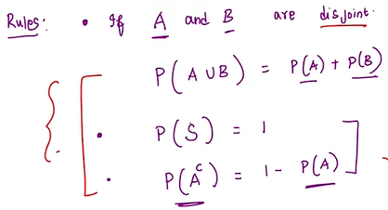
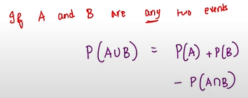
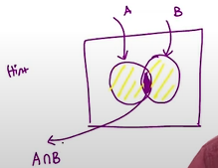
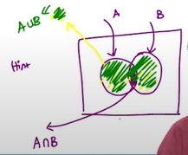
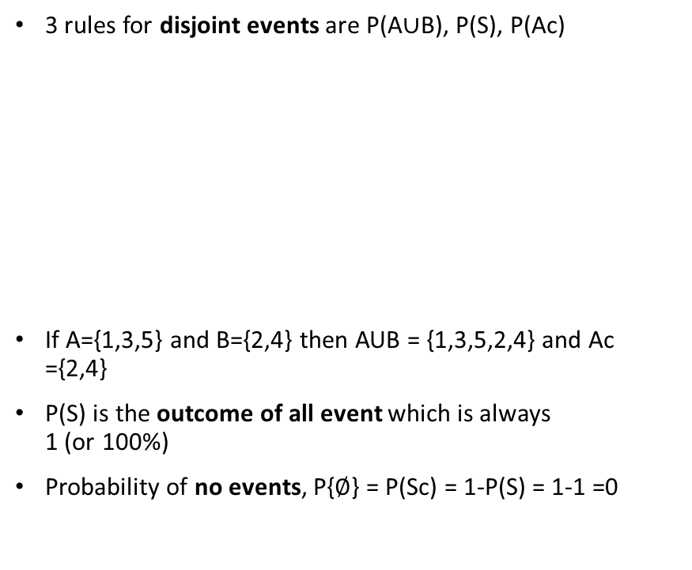
Disjoint/Non-disjoint Events
For non-disjoint events, P(AUB) is
3 rules for disjoint events are P(A$∪$B), P(S), P(Ac)
If A={1,3,5} and B={2,4} then AUB = {1,3,5,2,4} and Ac ={2,4}
P(S) is the outcome of all event which is always 1 (or 100%)
Probability of no events, P{$∅$} = P(Sc) = 1-P(S) = 1-1 =0

Slide 7
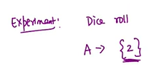
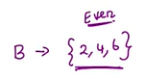
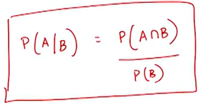
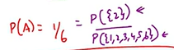
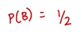
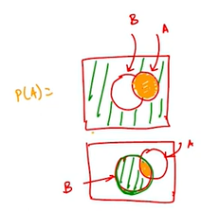
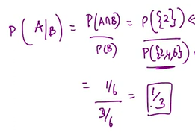
Conditional Probability Introducing conditional probability
P(A/B) is the probability of A if an event B happens
A fair dice is rolled where event A is {2} and event B is {2,4,6}
Probability of A increased from 1/2 to 1/3 when event B happens as sample space (possible outcome) decreased from {1,2,3,4,5,6} to {2,4,6}

Slide 8
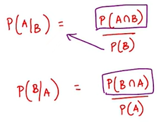
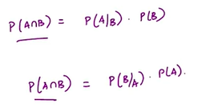
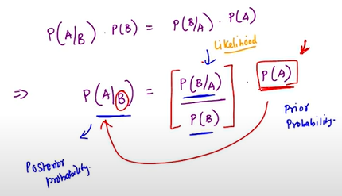
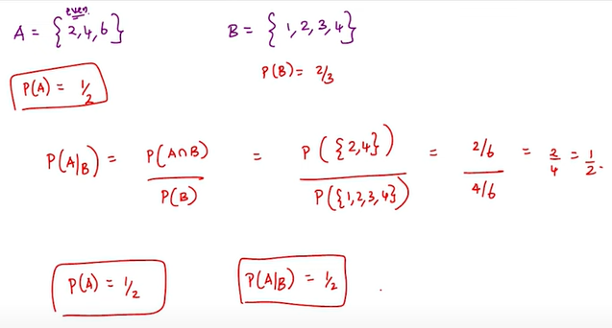
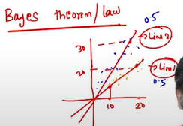
Bayes Theorem A short introduction to Bayes Theorem and independence
A and B independent events if P(A/B) = P(A) i.e. no change in the probability of an event A if event B happens
Line1 and Line2 represents relationship between Weight vs. Height in the graph and each line (event A) has respective chances for the data (event B)
Assume the probability of Line2 and Line1 increases and decreases after the data and Bayes theorem maps the probability for any line prior to the data P(A) and post the data P(A/B)
P(A/B) represents probability of line for given data and likelihood P(B/A) represents probability of data for given line.

Slide 9
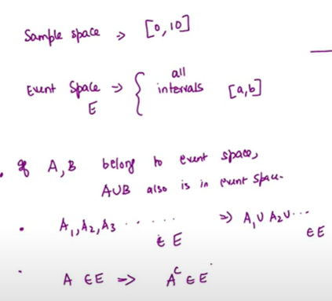
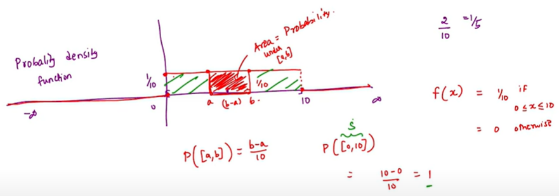
Continuous Probability Understand the difference between discrete and continuous probability and its density functions
An experiment has measured height with sample space ranges [0,10] will have infinite outcomes
Probability across the intervals for uniform distribution are generalized through probability density function, f(x)
Probability [a,b] is the area under curve given by area of rectangle = length(1/10)*breadth(b-a) and overall area is 1

Slide 10
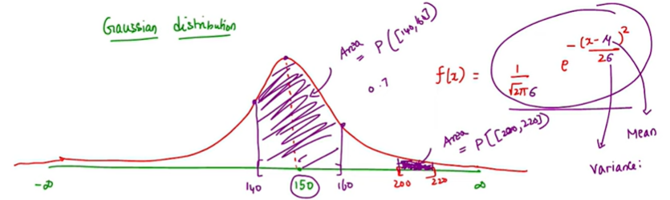
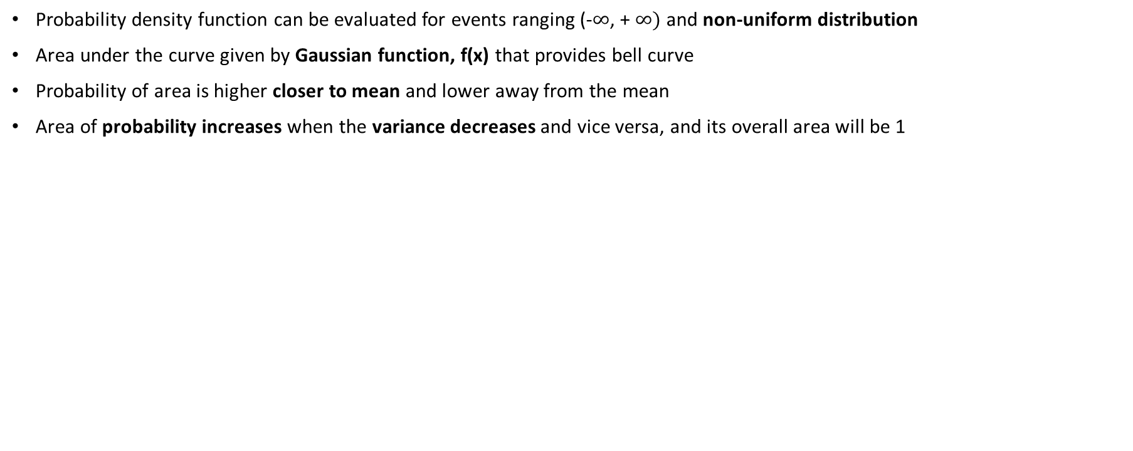
Gaussian Distribution
Probability density function can be evaluated for events ranging (-$∞$, + $∞)$ and non-uniform distribution
Area under the curve given by Gaussian function, f(x) that provides bell curve
Probability of area is higher closer to mean and lower away from the mean
Area of probability increases when the variance decreases and vice versa, and its overall area will be 1

Slide 11
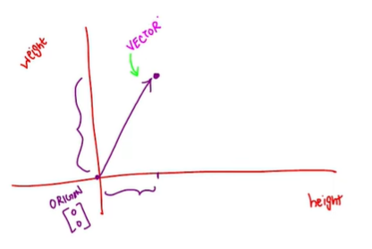
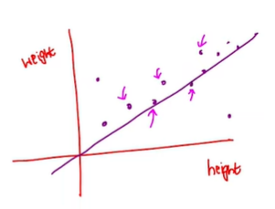
Introduction to Vectors Introducing components of linear algebra
Studying about the properties of line is linear algebra
Relationship between height and weight can be understood through a line
A point in 2D space is represented as vector, a line drawn from the origin and denoted with direction
All points are represented as a vector

Slide 12
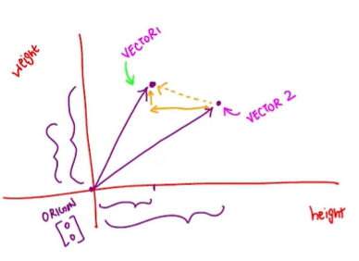
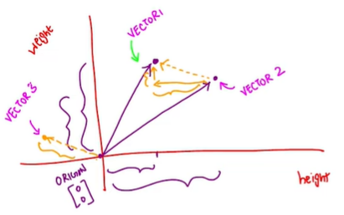
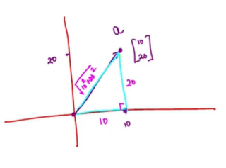
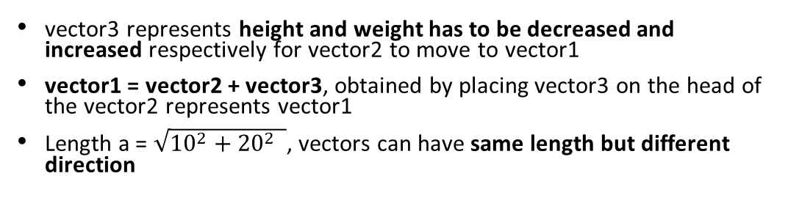
Introduction to Vectors
vector3 represents height and weight has to be decreased and increased respectively for vector2 to move to vector1
vector1 = vector2 + vector3, obtained by placing vector3 on the head of the vector2 represents vector1
Length a = $\sqrt{{10}^{2}+{20}^{2} }$, vectors can have same length but different direction

Slide 13
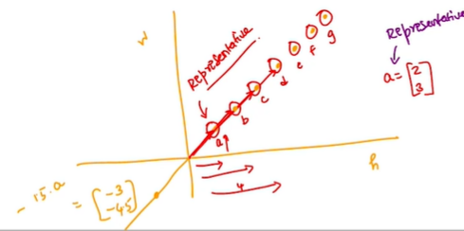
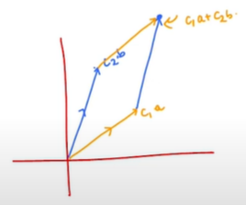
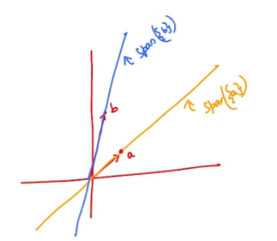
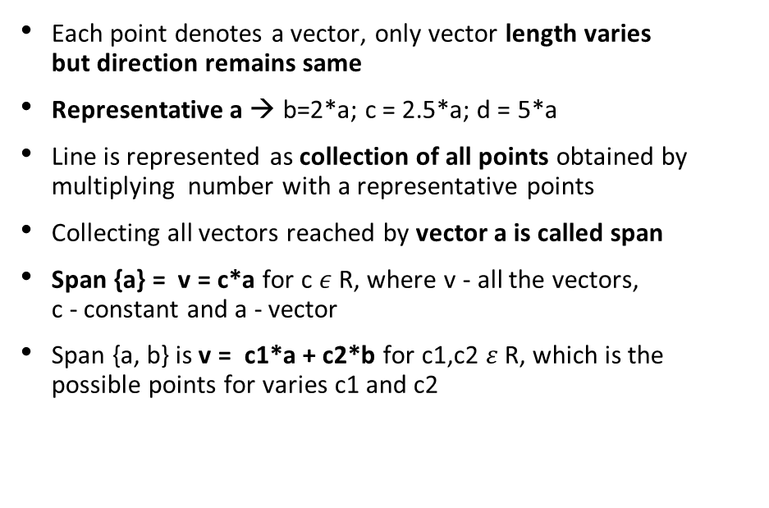
Span of Vectors Understand the concept of span of vectors
Each point denotes a vector, only vector length varies but direction remains same
Representative a → b=2*a; c = 2.5*a; d = 5*a
Line is represented as collection of all points obtained by multiplying number with a representative points
Collecting all vectors reached by vector a is called span
Span {a} = v = c*a for c $ε$ R, where v - all the vectors, c - constant and a - vector
Span {a, b} is v = c1*a + c2*b for c1,c2 $ε$ R, which is the possible points for varies c1 and c2

Slide 14
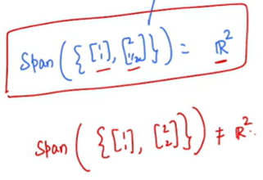
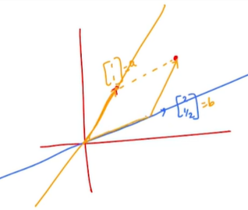
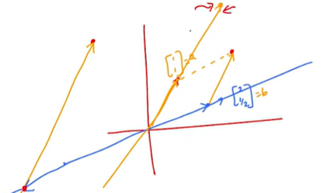
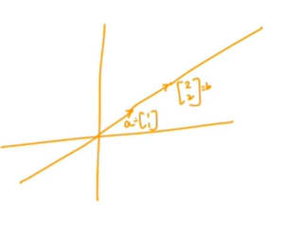
Vectors Span
All vectors that can be reached by the yellow line and blue line is Span (a, b)
Complete 2D space (R2) can be brought under by combining only two points a and b provided they are in different lines
Incase vectors are in same line; one point can be represented as other (dependent) and it cannot be brought under R2

Slide 15


Linear Independence & Basics When do you say given vectors are independent? Why that is helpful? Learn about one of the crucial components of linear algebra, that is, Basis of a vector space
Apart form multiplying with 0, if set of vectors are combined and brought to origin then it is said to be linearly dependent
Whatever the combination of vectors maybe if vectors cannot be brought to the origin, then it is said to be linearly independent
U is “Basics” of Rd, the set of vectors that can be spanned for entire space provided it is linearly independent
And all data points in the 3D plane (structure) are represented with u1,v1 vectors only
Linear independence helps to understand minimal vectors required to represent datapoints

Slide 16




Orthogonality What do we mean when we say two vectors are orthogonal? Why is it important?
If the closest point in the line from the vector X is identified that is represented with the same line, then separate line is not required
As point is in Span {u} it will be c.[u1 u2]. And c is (u1v1 + u2v2)/(u1*2 + u2*2), where vector u is direction and vector v is the point
Middle line is u1*v1 + u2*v2 = 0, consider any point in the middle point, the closest point from the vector v in the span {u} will be a origin.
Vectors u, v are orthogonal in d dimension if dot product or inner product, u1*v1 + u2*v2+…..+ ud*vd = 0
Only Vector u separates space R2 into yellow side (dot product > 0) and blue side (dot product < 0)

Slide 17


Projections
One vector can be transformed to another vector by multiplying with a matrix is called transformation
Any function is said to linear if any of these below properties is applicable, if input is multiplied twice output will be doubled or matrix A is multiplied for combination of vector (u1 + u2) it should be A*u1 + A*u2
For vectors u and v, given an input vector v matrix that projects to the closest point in vector u is called the projection matrix.
Vector v that is not plane are represented in the span {u1,u2) as P*V which is the closest point.

Slide 18



Performance Measure Problem setup, hypothesis and error calculation
Goal is to learn a function, which will provide an output (real number) with given input (test point). Identifying the best function (h) for the (x $ε$ Rd; y $ε$ R) out of the infinite functions
Performance measure (h) is calculated for all the points and summed up, where h(x) is the prediction for the input (x) and y is the actual
Identify a minimum function that has gives minimum error compared with all other functions
Goal is to generalise well in the test data rather than memorizing in training data. Minimizing error is important but objective is to identify a model that predict y from the input x

Slide 19



Linear Regression Gradient, minimize the error
Structure (w) is formalized through linear regression. X has d features [x1, x2,…..xd] and h(X) should be w1*x1 + w2*x2 + w3*x3+….wd*xd
Only linear function (WT*xi) is considered and identifying the best W from the infinite Ws that has minimum error in the training set.
Minimum function is obtained by gradient (where the partial derivative of $∇$w is 0)
W* provides the linear function that reduces the training error which is the solution to linear regression

Slide 20


Example
E.g. apple (20), orange (10) and grape (25) are identified from the linear expression formula
Only the linear structure is modelled and noise, the day today error are not modelled.
Best W* is identified through this method even though there are errors in the training data
3 apples, 2 oranges and 2 grapes combination is not available in the training set but the label 120 is predicted as W is identified

Slide 21


Geometrical Interpretation Geometrical Interpretation of closed-form solution, Issues with implementing closed-form solution
Each point in R6 represents the combination (apple + orange + grape) and any point in the grey area can be reached for prices of apple, orange, grape
Amount is in different plane (outside of grey) and its projections provides the closest point in the grey area represents the actual price for combination of apple, orange and grape. Error refers the difference between predicted to the actual
Geometrically, linear regression projects label vector (amount) onto the subspace (combination) spanned by the features (apples, oranges, grapes)

Slide 22


Slope & Intercept
Linear regression can be understood as a line that minimize the sum of squared error.
And ‘}’ in the graphs represents the error between the predicted versus the actual
Line represented a y = m*x+c, w1 representing as slope (m) and w2 represents intercepts (c)
For feature X [X1 1] and label y (actual), identifying the slope(m) and intercept (c) that minimize is same identifying w1 and w2
Find W* is computationally time-consuming task for very high volume of datapoints

Slide 23



Iterative Solution: Gradient Descent Understand iterative approach to find optimal weights
For dataset {(x1,y1), (x2,y2)……..(xm,ym)}, predicting a test point h([x1 x2 x3….xd]) for the weights (w) is formulated as
Solution to linear regression is obtained by weight that minimize the performance measure (Sum of squared error i.e., difference of predicted and actual)
W* can be identified from the expression but finding inverse of a matrix for million features (d) makes finding W difficult
Iterative method is well suited for the datasets that has huge number of features

Slide 24


Gradient Descent Working principle of GD, illustration with a simple example, Update rule
Create a function that identifies how good is the input parameter w [w1 w2] is close to the given data
Function can be loss or reward function (f value can be low or high); and if minimization function is f(x), then maximization function is - f(x)
Function with less dimension can be represented .e.g. f(x) is minimum at x =0 and function of X^2 will be either positive or zero.
Identifying minimizer is difficult for higher dimension and finding minimizer by randomly assigning values to x, is not a right approach.

Slide 25




Gradient Descent
f(x) is initialized with value of x and same point is utilized to move to the next point successively
To reach minimizer X should be m)oved towards left direction (if x > 0) or right direction (if x < 0)
‘d’ should be function, such that function is ‘+’ ve when ‘d’ is ‘-’ ve and vice versa
Function is oscillating and not reaching to minimizer despite the direction is correct

Slide 26



Choosing Step Size Effect of step-size in the update rule
How much the function should move in a particular direction is mentioned by step-size
Step size is generally 1/t and it is multiplied with 1 in 1st trial, ½ in 2nd trial, 1/3 in 3rd trial until minimizer is reached
Minimum value for the function is [5 3] and [7 4] is the initial point and gradient will have infinite direction
For [7 4] to attain minimizer, both x1 and x2 should reduce
Gradient generalize the derivative in the higher dimension

Slide 27




Taylor Series Understand the significance of negating the gradient.
Function value after moving ( for step size) to some point in a direction calculated from the function at current point f(x)
F(X + $∩∗d)$ is the function after moving in the direction d, and it should be less than f(x)
Wanted direction (d) such than L.H.S<0 and direction (d) should be chosen such that $∩∗d∗F^{′}\left(x\right)$<0
For $∩^{2},{ ∩}^{3}$ignored as it will be lesser than $∩$
Taylor series reduces function value in the chosen direction and for minimal step-size. And $− ∇$ f’(x) should be used for higher dimension

Slide 28



Taylor Series
Function value f(x) at a particular point is the slope –f’(x). Considering $∩df^{′}\left(x\right)$as linear function and gradient (direction) determined based on the slope increasing or decreasing at that particular point.
Slope gradually decrease and reach local minimizer and not the global minimizer. Quadratic functions have same local and global minimizer, called as convex function

Slide 29


Stochastic Gradient Descent 1. Using GD to solve linear regression problem 2.Using different basis function
Stochastic gradient computes samples datapoints randomly instead of million of datapoints
Gradient of those samples provides approximation to the actuals (million datapoints), called as Approximation
Quadratic function (blue) cannot be obtained for the any line and basis function is used for the non-linear relationship

Slide 30




Regularization & Ridge/Lasso 1. Significance of regularization. 2.Types of regularization
W2 [0 0 2] is preferred as only (height + weight) feature is sufficient for the output obtained through regularization
Ridge regression identifies W that minimize both least square loss and regularizer and hyperparameter($λ)$ balances
$λ$is identified through cross-validation, where $λ$ is provided to the training dataset and validated. Identify the best W (by passing $λ$ as input) that does prediction in validation dataset
Ridge regression regularizes by reducing feature weights, but Lasso regularizes W to exact 0 values.
Obtaining gradient in Lasso is difficult as L1-norm ||W||1 is a non-differentiable function
Generally, ridge is preferred over lasso as gradient/stochastic gradient algorithm can be applied easily. And ridge can be utilized in case features are not required to be eliminated

Slide 31




Logistic Regression Understand discriminant function and what it does to the input space; Drawbacks of strict threshold, Learn how sigmoid function overcomes it
Unlike the generative model, only features are discriminated but not generated with the assumptions; and it is preferred when the generative model fails due to the incorrect feature assumptions
Building model (line) y = 1 if WT*x > 0 and y = 0 if WT*x <= 0 will be a restrictive assumption for features that cant be distinguished into two classes
So label’s probability is associated with datapoint by sigmoid function such that it will increase from 0.5 to 1 when WT*x increases 0,1,2 etc… and will decrease from 0.5 to 0 when WT*x decreases 0, -1, -2 etc…

Slide 32


Maximum Likelihood Estimation Find the best parameter using maximum likelihood estimation
Logistics regression models P (y=1/x) = σ (WT*x)
Algorithm estimates W from the dataset; and Ytest is predicted for the given Xtest
Principle of maximum likelihood is to identify best W parameter from all the possible Ws
Gradient ascent algorithm is utilized to maximize the likelihood function
Logistic regression shall be tired as one of the first discriminative model in the binary classification
Historically, binary classification algorithms are built with the assumption that datasets are Linearly Separable

Slide 33



Perceptron Understand the Linear separability assumption; Introducing the perceptron model and its learning algorithm; Know the limitations of perceptron and emergence of new algorithms
Algorithm initialize W and validate if the predicted and actual labels are same, and update equation is used in case of label’s mismatch. It’s an iterative algorithm and updates W until all datapoints are predicted correctly.
Perceptron doesn’t always work for non-linearly separable datasets; but inspired the Artificial Neural Networks and Support Vector Machines. It will identify the line that separates dataset, but it shouldn’t be necessarily an optimal line

Slide 34




Support Vector Machine Understand the Support Vector Machine and how it differs from Perceptron
Unlike perceptron algorithm, the SVM algorithm identifies the optimal line for the linearly separable dataset
SVM algorithm figure out the best line for a linearly separable datasets with respect to ‘Quality of Separation’
For Vector W, the ‘Quality of Separation’ is the maximum width between boundary lines (WX=$γ$ & WT*X=-$γ)$that separates class 0 and class 1, and ‘$γ′$ is the distance from the line WT*X = 0
Algorithm identifies best vector ‘W’ by measuring 2/||W||2, fixing boundary lines as ‘$γ$ = 1’

Slide 35




Optimizing Weights 1. Find weight vectors that maximize the margin using optimization 2.Shortcomings of SVM
Consider a binary classification dataset {(x1,x2), (x2,y2)……(xm,ym)} where Xi $ε$ Rd and labels Yi = {+1,-1}
Optimum vector W is obtained with minimization function amongst the vectors that satisfies the separation condition provided it is a linearly separable dataset and without outlier
SVM algorithm will fail if the datasets are
non- linearly separable
with outliers
higher order separable
higher order separable and with outliers

Slide 36



Handling Outliers Understand the Primal formulation of SVM to handle outliers
Outlier doesn’t satisfy separation condition and it is penalized with$εi$to move to right class and it’s summed up for the m datapoints
If $λ$=0, algorithm moves outlier to right class without penalizing ; and $λ$= $∞$ is applicable for linearly separable dataset with no outlier. Hyper-parameter $λ,$balances the width and total penalty and best $λ$ is cross validated.
Hard margin is converted into soft margin for non-linearly separable dataset

Slide 37





Dual Formulation Understand primal and dual formulation of optimization problems in a general setting
Both f(w) and g(w) are the functions for a parameter ‘w’ and objective is to minimize f(w) that satisfies constraints g(w)
Lagrangian function include g(w) and for fixed ‘w’, maximizing $λ$ will result in f(w) satisfying constraints g(w)
Minimum f(w) for primal is as below and minimize and maximize is swapped for the dual problem

Slide 38




Kernel formulation Understand the emergence of Kernel from the dual formulation
Dual problem for SVM with constraints for each datapoint is represented as
Fixing $λ$ simplifies minimization, and the optimal W* obtained is substituted in the dual formulation
Similarities between datapoints XT*X are provided by Kernel XiT*Xj learns decision boundaries other than line
Primal soft-margin is converted into dual formulation by choosing kernel & balancing parameter by cross validation
Weights are dependent on the datapoints in the supporting lines called support vectors

Slide 39


Classification & K Nearest Neighbour Recap & Example classification problems, classification problem setup & Neighbours, outliers, k-neighbours
Classification labels will have fixed values, and labels will be either {0,1} or {+1,-1} in binary classification
Feature vector (X) created for each mail and it has supervision (labels) as spam (0) and non-spam (1). New email is classified based on the model (function h) learnt from the training dataset.
Test point is classified as red based on the label of the nearest feature (x) data point. To overcome incorrect prediction due to outliers or noise in the datasets, majority of the labels of the nearest neighbours are considered

Slide 40

Cross Validation & Computational efficiency Euclidean distance, finding optimal value for k, cross validation, Distance function, computational time, learning
Euclidean distance of the neighbours from the test data is calculated for K datapoints and its majority of labels is considered for prediction
K (hyper parameter) with highest accuracy is chosen through cross validation stepping as 1,3,5 etc
Bags are created randomly to eliminate incorrect accuracy due to outliers in the validation set
For test point, distance is calculated for each point and sorted to identify nearest K neighbouring points and training dataset can’t be ignored for prediction
Distance is evaluated for 0 (nlogn) times for ‘n’ datapoints which is time consuming and euclidean distance function may not be accurate always
It is a simplest algorithm but not effective as no model is learnt

Slide 41



Decision Trees & Level splitting Why tree structure? Understand the splitting criteria in Decision trees
Unlike KNN algorithm, datapoints are not required as decision tree model learns
Question is a feature, value pair; the algorithm checks f2 < 7 at the root node and further checks if f4 < 2.3 for Xtest and then classify as class 1 at the classification layer
Fk < $θ$ is applied in the training set and each datapoints are bucketized as Dyes and Dno based on feature
If those features contains same label in both buckets then it is a right question; and for mixed labels, it is evaluated through measure of impurity

Slide 42



Measure of Impurity and Entropy & Information Gain Use entropy to measure the impurity of a node, Using Information gain to build a tree, hyper-parameter for the tree
Measure of Impurity (P) is evaluated with labels and cardinality (total number of data points),|Dyes| or |Dno|
Entropy (P) increase (from 0 to 0.5) and decrease (0.5 to 1) and measured through –[P*log(P) + (1-P)*log (1-P)]
Information gain (Fk,$θ)$ is evaluated with the entropy difference before and after questioning
Range for each features are discretized for questioning and (Fk,$θ$) having maximum information gain is questioned at root node
Dataset gets purified in the successive levels and cross validation is performed to identify heights (hyperparameter)
Model learns but evaluating information gain for too many questions is time consuming and domain knowledge is required to discretize features appropriately

Slide 43



Naive Bayes Joint distribution, probability, discriminant functions, Parameters of Naive Bayes, Feasibility of learning the parameters
Data uncertainties are modelled in discriminative (labels) and generative (labels & features) models
P(y=1/x) is given by function ‘$σ\text{‘}\text{, }\text{an}$d Xtest is predicted by identifying parameters from the training datasets
In spam classification, each email is represented with binary feature {0,1} based on the dictionary words
P(x,y) = P(y).P(x/y) is modelled generating probabilistic story (feature, label) for every datapoint
Spam/non-spam email (Yi) assumed to be generated by tossing a coin, and dictionary words (Xi) for an email assumed to be generated by rolling 8 faced dice (3 words)
Probability of coin (1), dice1 (2^d) and dice2 (2^d) are the parameters learnt from the dataset following the above procedure

Slide 44


Conditional Independence & Prediction Naive Bayes example
Parameters are reduced assuming features are conditionally independent given the label
Words are assumed to be generated by tossing 3 coins separately with 2d+1 parameters
Estimated email’s probability is no. of spam emails by total no. of emails and estimated word’s probability is no. of spam emails with particular word i by no. of spam emails
Probabilities of spam/non-spam emails and their corresponding features are evaluated for the test data and email with higher probability is identified applying bayes rule
As parameters are simplified (naive) and bayes rule is applied to predict data, it is called Naive Bayes algorithm

